Slide 1
6.814/6.830 Lecture 8
Column Stores
Join Algorithms
10/2/2017

Slide 2



C-Store: Rethinking Database Design from the Ground Up
Inserts
Column-oriented query executor
Write optimized storage
Tuple
Mover
SYM
PRICE
VOL
EXCH
TIME
SYM
PRICE
VOL
EXCH
TIME
IBM |  | 100 |  | 10244 |  | NYSE |  | 1.17.07
IBM |  | 102 |  | 11245 |  | NYSE |  | 1.17.07
SUN |  | 58 |  | 3455 |  | NQDS |  | 1.17.07
Shared nothing
horizontal partitioning
IBM |  | 100 |  | 10244 |  | NYSE |  | 1.17.07
IBM |  | 102 |  | 11245 |  | NYSE |  | 1.17.07
SUN |  | 58 |  | 3455 |  | NQDS |  | 1.17.07
Separate Files
Column-based Compression
“C-Store: A Column-oriented DBMS” -- VLDB 05

Slide 3
Query Processing Example
SELECT avg(price)
FROM tickstore
WHERE symbol = ‘GM’
AND date = ‘1/17/2007’
Traditional Row Store
AVG
price
Complete tuples
SELECT
date=’1/17/07’
Complete tuples
SELECT
sym = ‘GM’
Complete tuples
Disk
GM | 30.77 | 1,000 | NYSE | 1/17/2007
GM | 30.77 | 10,000 | NYSE | 1/17/2007
GM | 30.78 | 12,500 | NYSE | 1/17/2007
AAPL | 93.24 | 9,000 | NQDS | 1/17/2007
Notes:
Disco picture/hippie joke

Slide 4

Query Processing Example
Basic Column Store
“Early Materialization”
SELECT avg(price)
FROM tickstore
WHERE symbol = ‘GM’
AND date = ‘1/17/2007’
Complete tuples
AVG
price
Complete tuples
Row-oriented plan
SELECT
date=’1/17/07’
Complete tuples
Construct Tuples
SELECT
sym = ‘GM’
GM | 30.77 | 1/17/07
Disk
GM
GM
GM
AAPL
30.77
30.77
30.78
93.24
1,000
10,000
12,500
9,000
1/17/2007
1/17/2007
1/17/2007
1/17/2007
Fields from same tuple at same index (position) in each column file
NYSE
NYSE
NYSE
NQDS

Slide 5
Query Processing Example
AVG
Much less data flowing through memory
C-Store
“Late Materialization”
Prices
Position Lookup
Position Bitmap
(1,1,1,0)
AND
Position Bitmap
(1,1,1,0)
Position Bitmap
(1,1,1,1)
Pos.SELECT
sym = ‘GM’
Pos.SELECT
date=’1/17/07’
Disk
GM
GM
GM
AAPL
30.77
30.77
30.78
93.24
1,000
10,000
12,500
9,000
NYSE
NYSE
NYSE
NQDS
1/17/2007
1/17/2007
1/17/2007
1/17/2007
See Abadi et al
ICDE 07
Notes:
Reread IQ papers on bitmap indexes and index ANDing

Slide 6
Why Compress?
Database size is 2x-5x larger than the volume of data loaded into it
Database performance is proportional to the amount of data flowing through the system
Abadi et al, SIGMOD 06

Slide 7
Column-Oriented Compression
Query engine processes compressed data
Transfers load from disk to CPU
Multiple compression types
Run-Length Encoding (RLE), LZ, Delta Value, Block Dictionary Bitmaps, Null Suppression
System chooses which to apply
Typically see 50% - 90% compression
NULLs take virtually no space
Columns contain similar data, which makes compression easy
RLE
Delta
LZ
RLE
RLE
GM
GM
GM
AAPL
3xGM
1XAPPL
30.77
+0
+.01
+62.47
30.77
30.77
30.78
93.24
1,000
10,000
12,500
9,000
1,000
10,000
12,500
9,000
NYSE
NYSE
NYSE
NQDS
3xNYSE
1XNQDS
1/17/2007
1/17/2007
1/17/2007
1/17/2007
4 x 1/17/2007
Notes:
As mentioned in the previous slide, another way you can minimize disk I/O is through aggressive compression
Vertica makes use of the following compression techniques
RLE, LZ, Block Delta Values, Common Delta Value, Block Dictionary, and ? (chuck’s)
By doing aggressive compression, Vertica:
Increases performance, by reducing disk I/O
Reduces storage
You can store more in less space, less physical data on disk means less reads
Offloads the work from disk to CPU
The advantage of offloading to CPU is it is better at multiprocessing; it is easy to have several users on the same CPU. With disk, it’s much harder, the head on a disk can only read one section at a time. CPU allows for more concurrency.
CPU scales out much easier. You get a better bang for the buck.
Not all encodings are necessarily CPU intensive; both RLE and Block Dictionary often require less CPU because Vertica’s operators are built to process data natively in those formats; they don’t have to be decoded before being computed or retrieved.
Data only uncompresses when results are sent (vs. other DBs have to uncompress at query time which slows it down)
Database Designer makes choosing the right compression types easy since it recommends the best projections to use based on your sample queries (more on that in number 5).
Typically in a row store with indexing, padding, MVs etc they end up storing 5x more than the actual data
Possible questions:
How does this compare to row stores?
Row stores only really use LV
How does this differ from Sybase IQ?
Sybase IQ only uses bitmap compressions
Definitions of Compression types
RLE – instead of storing every instance of a value (state) instead we store one instance and the number of times it is repeated (basically eliminates columns)
LZ – Zipping. Used for data that isn’t well organized (comments fields etc)
Delta Value – when you have unique numberic data that’s related (phone number) – instead of storing all 10 digits, you’ll store the lowest level and then the difference between the next
Block Dictionary -

Slide 8
Operating on Compressed Data
AVG
Only possible with late materialization!
Prices
Position Lookup
Position Bitmap
(3x1,1x0)
AND
Position Bitmap
(3x1,1x0)
Position Bitmap
(4x1)
Compression Aware
Pos.SELECT
sym = ‘GM’
Pos.SELECT
date=’1/17/07’
Disk
3xGM
1xAPPL
30.77
+0
+.01
+62.47
1,000
10,000
12,500
9,000
NYSE
NYSE
NYSE
NQDS
4x1/17/2007

Slide 9
Direct Operation Optimizations
Compressed data used directly for position lookup
RLE, Dictionary, Bitmap
Direct Aggregation and GROUP BY on compressed blocks
RLE, Dictionary
Join runs of compressed blocks
RLE, Dictionary
Min/max directly extracted from sorted data

Slide 10
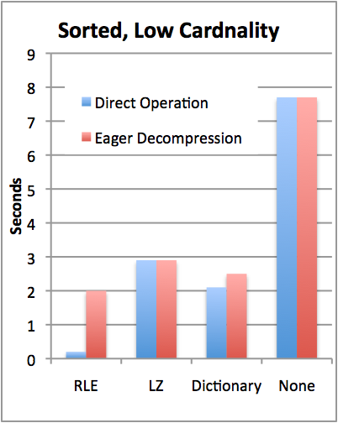
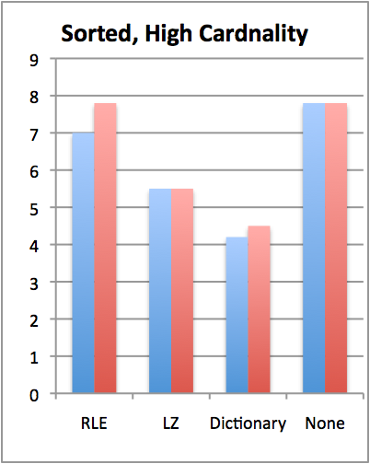

TPC-H Compression Performance
Y | X
1 | A
1 | C
1 | D
2 | B
2 | C
3 | A
Query: SELECT colY, SUM(colX)
FROM lineItem GROUP BY colY
TPC-H Scale 10 (60M records)
Sorted on colY, then colX
colY uncompressed, cardinality varies
Notes:
Consider redesigning

Slide 11
Compression + Sorting is a Huge Win
How can we get more sorted data?
Store duplicate copies of data
Use different physical orderings
Improves ad-hoc query performance
Due to ability to directly operate on sorted, compressed data
Supports fail-over / redundancy
Notes:
We need a new slide that discusses high availability. (Possibly add in a diagram in Vertica tech whitepaper that has a good picture of HA).
Physical schema design duplicates columns on various machines so if one machine goes down you still have a copy.
With traditional systems, you usually have to have two identical systems
No benefit to having two systems
Only use second system on the slim chance that the first goes down.
Wouldn’t it be better if both systems had the same data, but both were optimized for different query workloads?
Vertica makes use of both systems through node clustering
We rope it all into one system,
We provide High Availability and the k-safety you need
k is a measure of the meantime to failure, meantime to recovery
We can do this without dulling computing, because the columns are compressed
We can duplicate columns while still saving space and maintaining k-safe
Redundancy – will get restored by querying the nodes that were running for what happened.
Replication – a DB feature used to replicate a transaction in another DB in order to keep the data in 2 places (use ETL, golden gate etc)
Mirroring (disk) - for redundancy (HW solution). We don’t need that extra cost (all machines do stufff)

Slide 12
Write Performance
Trickle load: Very Fast Inserts
Tuple Mover
Asynchronous Data
Movement
Batched
Amortizes seeks
Amortizes recompression
Enables continuous load
Queries read from both WOS and ROS
Notes:
Writes performance was a surprise

Slide 13
When to Rewrite ROS Objects?
Store multiple ROS objects, instead of just one
Each of which must be scanned to answer a query
Tuple mover writes new objects
Avoids rewriting whole ROS on merge
Periodically merge ROS objects to limit number of distinct objects that must be scanned (like Big Table)
Older objects
Tuple Mover
WOS
ROS

Slide 14
C-Store Performance
How much do these optimizations matter?
Wanted to compare against best you could do with a commercial system

Slide 15
Emulating a Column Store
Two approaches:
Vertical partitioning: for n column table, store n two-column tables, with ith table containing a tuple-id, and attribute i
Sort on tuple-id
Merge joins for query results
Index-only plans
Create a secondary index on each column
Never follow pointers to base table

Slide 16
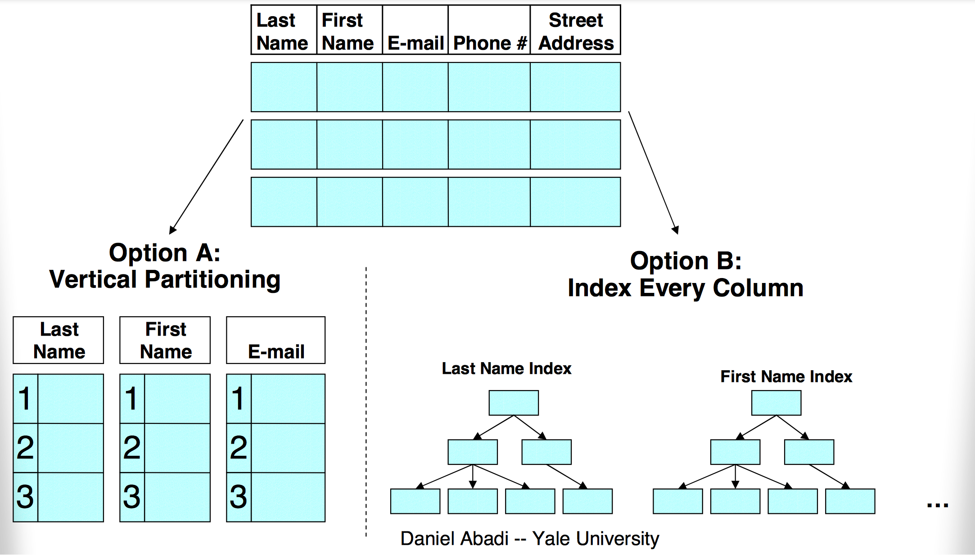
Two Emulation Approaches

Slide 17
Bottom Line
SSBM (Star Schema Benchmark -- O’Neil et al ICDE 08)
Data warehousing benchmark based on TPC-H
Scale 100 (60 M row table), 17 columns
Average across 12 queries
Row store is a commercial DB, tuned by professional DBA vs C-Store
Commercial System Does Not Benefit From Vertical Partitioning
Time (s)
Notes:
Row store partitions on date

Slide 18
Problems with Traditional Executors
Tuple headers
Total table is 4GB
Each column table is ~1.0 GB
Factor of 4 overhead from tuple headers and tuple-ids
Merge joins
Answering queries requires joins
Row-store doesn’t know that column-tables are sorted
Sort hurts performance
Column stores can efficiently go from tuple ID→value in each column
But indexes map from value→tuple ID!
Would need to fix these, plus add direct operation on compressed data, to approach C-Store performance

Slide 19
Recommendations for Row-Store Designers
Might be possible to get C-Store like performance
Need to store tuple headers elsewhere (not require that they be read from disk w/ tuples)
Need to provide efficient merge join implementation that understands sorted columns
Need to support direct operation on compressed data
Requires “late materialization” design

Slide 20
Summary
C-Store is a “next gen” column-oriented databases
Key New Ideas:
Late materialization
Compression & direct operation
Fast load via “write optimized store”
Row-stores do a poor job of emulation
Need better support for compression, late materialization
Need support for narrow tuples, efficient merge joins
C-Store: http://db.csail.mit.edu/cstore
20
Notes:
Should be at 30 minutes here.

Slide 21
Plan questions
Π_{ename,count}
𝛔_{count > 7}
𝛂_{agg:count(*), group by ename}
Order?
Next Lecture
⨝
eno=eno
Implementation? – This Lecture
⨝
dno=dno
kids
𝛔_{name=‘eecs’}
𝛔_{sal>50k}
Storage model & access methods – Previous lectures
dept
emp

Slide 22
Study Break
When would you prefer sort-merge over hash join?
When would you prefer index-nested-loops join over hash join?

Slide 23
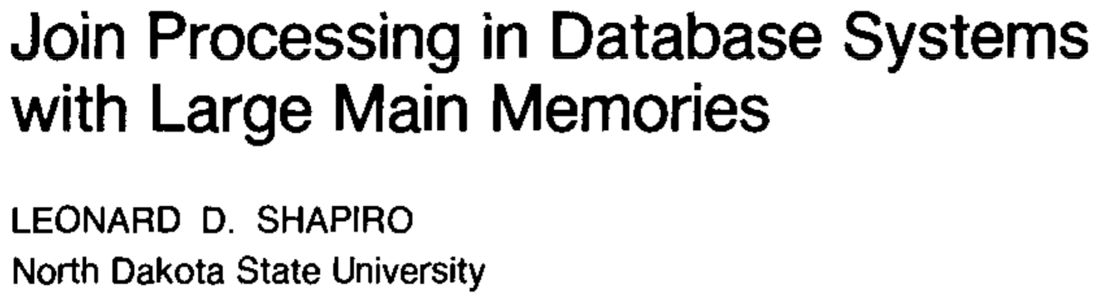

Slide 24
Sort Merge Join
Equi-join of two tables S & R
|S| = Pages in S; {S} = Tuples in S
|S| ≥ |R|
M pages of memory; M > sqrt(|S|)
Algorithm:
Partition S and R into memory sized sorted runs, write out to disk
Merge all runs simultaneously
Total I/O cost: Read |R| and |S| twice, write once
3(|R| + |S|) I/Os

Slide 25
Example
R=1,4,3,6,9,14,1,7,11
S=2,3,7,12,9,8,4,15,6
R1 = 1,3,4
S1 = 2,3,7 S2 = 8,9,12 S3 = 4,6,15
If each run is M pages and M > sqrt(|S|), then there are at most
|S|/sqrt(|S|) = sqrt(|S|)
runs of S
So if |R| = |S|, we actually need M to be 2 x sqrt(|S|)
[handwavy argument in paper for why it’s only sqrt(|S|)]
R2 = 6,9,14 R3 = 1,7,11
OUTPUT
R1 | R2 | R3 | S1 | S2 | S3
1 | 6 | 1 | 2 | 8 | 4
3 | 9 | 7 | 3 | 9 | 6
4 | 14 | 11 | 7 | 12 | 15
Need enough memory to keep 1 page of each run in memory at a time

Slide 26
Example
R=1,4,3,6,9,14,1,7,11
S=2,3,7,12,9,8,4,15,6
R1 = 1,3,4 R2 = 6,9,14 R3 = 1,7,11
S1 = 2,3,7 S2 = 8,9,12 S3 = 4,6,15
OUTPUT
R1 | R2 | R3 | S1 | S2 | S3
1 | 6 | 1 | 2 | 8 | 4
3 | 9 | 7 | 3 | 9 | 6
4 | 14 | 11 | 7 | 12 | 15

Slide 27
Example
R=1,4,3,6,9,14,1,7,11
S=2,3,7,12,9,8,4,15,6
R1 = 1,3,4 R2 = 6,9,14 R3 = 1,7,11
S1 = 2,3,7 S2 = 8,9,12 S3 = 4,6,15
OUTPUT
R1 | R2 | R3 | S1 | S2 | S3
1 | 6 | 1 | 2 | 8 | 4
3 | 9 | 7 | 3 | 9 | 6
4 | 14 | 11 | 7 | 12 | 15

Slide 28
Example
R=1,4,3,6,9,14,1,7,11
S=2,3,7,12,9,8,4,15,6
R1 = 1,3,4 R2 = 6,9,14 R3 = 1,7,11
S1 = 2,3,7 S2 = 8,9,12 S3 = 4,6,15
OUTPUT
(3,3)
R1 | R2 | R3 | S1 | S2 | S3
1 | 6 | 1 | 2 | 8 | 4
3 | 9 | 7 | 3 | 9 | 6
4 | 14 | 11 | 7 | 12 | 15

Slide 29
Example
R=1,4,3,6,9,14,1,7,11
S=2,3,7,12,9,8,4,15,6
R1 = 1,3,4 R2 = 6,9,14 R3 = 1,7,11
S1 = 2,3,7 S2 = 8,9,12 S3 = 4,6,15
OUTPUT
(3,3)
(4,4)
R1 | R2 | R3 | S1 | S2 | S3
1 | 6 | 1 | 2 | 8 | 4
3 | 9 | 7 | 3 | 9 | 6
4 | 14 | 11 | 7 | 12 | 15

Slide 30
Example
R=1,4,3,6,9,14,1,7,11
S=2,3,7,12,9,8,4,15,6
R1 = 1,3,4 R2 = 6,9,14 R3 = 1,7,11
S1 = 2,3,7 S2 = 8,9,12 S3 = 4,6,15
OUTPUT
(3,3)
(4,4)
R1 | R2 | R3 | S1 | S2 | S3
1 | 6 | 1 | 2 | 8 | 4
3 | 9 | 7 | 3 | 9 | 6
4 | 14 | 11 | 7 | 12 | 15

Slide 31
Example
R=1,4,3,6,9,14,1,7,11
S=2,3,7,12,9,8,4,15,6
R1 = 1,3,4 R2 = 6,9,14 R3 = 1,7,11
S1 = 2,3,7 S2 = 8,9,12 S3 = 4,6,15
OUTPUT
(3,3)
(4,4)
(6,6)
R1 | R2 | R3 | S1 | S2 | S3
1 | 6 | 1 | 2 | 8 | 4
3 | 9 | 7 | 3 | 9 | 6
4 | 14 | 11 | 7 | 12 | 15

Slide 32
Example
R=1,4,3,6,9,14,1,7,11
S=2,3,7,12,9,8,4,15,6
R1 = 1,3,4 R2 = 6,9,14 R3 = 1,7,11
S1 = 2,3,7 S2 = 8,9,12 S3 = 4,6,15
OUTPUT
(3,3)
(4,4)
(6,6)
(7,7)
R1 | R2 | R3 | S1 | S2 | S3
1 | 6 | 1 | 2 | 8 | 4
3 | 9 | 7 | 3 | 9 | 6
4 | 14 | 11 | 7 | 12 | 15
…
Output in sorted order!

Slide 33
Simple Hash
Algorithm:
Given hash function H(x) → [0,…,P-1] (e.g., x mod P)
where P is number of partitions
for i in [0,…,P-1]:
for each r in R:
if H(r)=i, add r to in memory hash
otherwise, write r back to disk in R’
for each s in S:
if H(s)=i, lookup s in hash, output matches
otherwise, write s back to disk in S’
replace R with R’, S with S’

Slide 34
Simple Hash I/O Analysis
Suppose P=2, and hash uniformly maps tuples to partitions
Read |R| + |S|
Write 1/2 (|R| + |S|)
Read 1/2 (|R| + |S|) = 2 (|R| + |S|)
P=3
Read |R| + |S|
Write 2/3 (|R| + |S|)
Read 2/3 (|R| + |S|)
Write 1/3 (|R| + |S|)
Read 1/3 (|R| + |S|) = 3 (|R| + |S|)
P=4
|R| + |S| + 2 * (3/4 (|R| + |S|)) + 2 * (2/4 (|R| + |S|)) + 2 * (1/4 (|R| + |S|))
= 4 (|R| + |S|)
➔ P = n ; n * (|R| + |S|) I/Os

Slide 35
Grace Hash
Algorithm:
Partition:
Suppose we have P partitions, and H(x) → [0…P-1]
Choose P = |S| / M ➔ P ≤ sqrt(|S|) //may need to leave a little slop for imperfect hashing
Allocate P 1-page output buffers, and P output files for R
For each r in R:
Write r into buffer H(r)
If buffer full, append to file H(r)
Allocate P output files for S
For each s in S:
Write s into buffer H(s)
if buffer full, append to file H(s)
Join:
For i in [0,…,P-1]
Read file i of R, build hash table
Scan file i of S, probing into hash table and outputting matches
Need one page of RAM for each of P partitions
Since
M > sqrt(|S|) and
P ≤ sqrt(|S|), all is well
Total I/O cost: Read |R| and |S| twice, write once
3(|R| + |S|) I/Os

Slide 36
Example
P = 3; H(x) = x mod P
R=5,4,3,6,9,14,1,7,11
S=2,3,7,12,9,8,4,15,6
R0 | R1 | R2
F0 | F1 | F2
P output buffers
P output files

Slide 37
Example
P = 3; H(x) = x mod P
R=5,4,3,6,9,14,1,7,11
S=2,3,7,12,9,8,4,15,6
R0 | R1 | R2
 |  | 5
F0 | F1 | F2

Slide 38
Example
P = 3; H(x) = x mod P
R=5,4,3,6,9,14,1,7,11
S=2,3,7,12,9,8,4,15,6
R0 | R1 | R2
 | 4 | 5
F0 | F1 | F2

Slide 39
Example
P = 3; H(x) = x mod P
R=5,4,3,6,9,14,1,7,11
S=2,3,7,12,9,8,4,15,6
R0 | R1 | R2
3 | 4 | 5
F0 | F1 | F2

Slide 40
Example
P = 3; H(x) = x mod P
R=5,4,3,6,9,14,1,7,11
S=2,3,7,12,9,8,4,15,6
R0 | R1 | R2
3 | 4 | 5
6
F0 | F1 | F2

Slide 41
Example
P = 3; H(x) = x mod P
R=5,4,3,6,9,14,1,7,11
S=2,3,7,12,9,8,4,15,6
R0 | R1 | R2
3 | 4 | 5
6
F0 | F1 | F2
Need to flush R0 to F0!

Slide 42
Example
P = 3; H(x) = x mod P
R=5,4,3,6,9,14,1,7,11
S=2,3,7,12,9,8,4,15,6
R0 | R1 | R2
 | 4 | 5
F0 | F1 | F2
3
6

Slide 43
Example
P = 3; H(x) = x mod P
R=5,4,3,6,9,14,1,7,11
S=2,3,7,12,9,8,4,15,6
R0 | R1 | R2
9 | 4 | 5
F0 | F1 | F2
3
6

Slide 44
Example
P = 3; H(x) = x mod P
R=5,4,3,6,9,14,1,7,11
S=2,3,7,12,9,8,4,15,6
R0 | R1 | R2
9 | 4 | 5
 |  | 14
F0 | F1 | F2
3
6

Slide 45
Example
P = 3; H(x) = x mod P
R=5,4,3,6,9,14,1,7,11
S=2,3,7,12,9,8,4,15,6
R0 | R1 | R2
9 | 4 | 5
 | 1 | 14
F0 | F1 | F2
3
6

Slide 46
Example
P = 3; H(x) = x mod P
R=5,4,3,6,9,14,1,7,11
S=2,3,7,12,9,8,4,15,6
R0 | R1 | R2
9 | 4 | 5
 | 1 | 14
F0 | F1 | F2
3
6

Slide 47
Example
P = 3; H(x) = x mod P
R=5,4,3,6,9,14,1,7,11
S=2,3,7,12,9,8,4,15,6
R0 | R1 | R2
9 |  | 5
 |  | 14
F0 | F1 | F2
3 | 4
6 | 1

Slide 48
Example
P = 3; H(x) = x mod P
R=5,4,3,6,9,14,1,7,11
S=2,3,7,12,9,8,4,15,6
R0 | R1 | R2
9 | 7 | 5
 |  | 14
F0 | F1 | F2
3 | 4
6 | 1

Slide 49
Example
P = 3; H(x) = x mod P
R=5,4,3,6,9,14,1,7,11
S=2,3,7,12,9,8,4,15,6
R0 | R1 | R2
9 | 7 | 5
 |  | 14
F0 | F1 | F2
3 | 4
6 | 1

Slide 50
Example
P = 3; H(x) = x mod P
R=5,4,3,6,9,14,1,7,11
S=2,3,7,12,9,8,4,15,6
R0 | R1 | R2
9 | 7
F0 | F1 | F2
3 | 4 | 5
6 | 1 | 14

Slide 51
Example
P = 3; H(x) = x mod P
R=5,4,3,6,9,14,1,7,11
S=2,3,7,12,9,8,4,15,6
R0 | R1 | R2
9 | 7 | 11
F0 | F1 | F2
3 | 4 | 5
6 | 1 | 14

Slide 52
Example
P = 3; H(x) = x mod P
R=5,4,3,6,9,14,1,7,11
S=2,3,7,12,9,8,4,15,6
R0 | R1 | R2
F0 | F1 | F2
3 | 4 | 5
6 | 1 | 14
9 | 7 | 11

Slide 53
Example
P = 3; H(x) = x mod P
R=5,4,3,6,9,14,1,7,11
S=2,3,7,12,9,8,4,15,6
R Files
S Files
F0 | F1 | F2
3 | 4 | 5
6 | 1 | 14
9 | 7 | 11
F0 | F1 | F2
3 | 7 | 2
12 | 4 | 8
9
15
6

Slide 54
Example
P = 3; H(x) = x mod P
R=5,4,3,6,9,14,1,7,11
S=2,3,7,12,9,8,4,15,6
Matches:
R Files
S Files
F0 | F1 | F2
3 | 4 | 5
6 | 1 | 14
9 | 7 | 11
F0 | F1 | F2
3 | 7 | 2
12 | 4 | 8
9
15
6
Load F0 from R into memory

Slide 55
Example
P = 3; H(x) = x mod P
R=5,4,3,6,9,14,1,7,11
S=2,3,7,12,9,8,4,15,6
Matches:
R Files
S Files
F0 | F1 | F2
3 | 4 | 5
6 | 1 | 14
9 | 7 | 11
F0 | F1 | F2
3 | 7 | 2
12 | 4 | 8
9
15
6
Load F0 from R into memory
Scan F0 from S

Slide 56
Example
P = 3; H(x) = x mod P
R=5,4,3,6,9,14,1,7,11
S=2,3,7,12,9,8,4,15,6
Matches:
3,3
R Files
S Files
F0 | F1 | F2
3 | 4 | 5
6 | 1 | 14
9 | 7 | 11
F0 | F1 | F2
3 | 7 | 2
12 | 4 | 8
9
15
6
Load F0 from R into memory
Scan F0 from S

Slide 57
Example
P = 3; H(x) = x mod P
R=5,4,3,6,9,14,1,7,11
S=2,3,7,12,9,8,4,15,6
Matches:
3,3
R Files
S Files
F0 | F1 | F2
3 | 4 | 5
6 | 1 | 14
9 | 7 | 11
F0 | F1 | F2
3 | 7 | 2
12 | 4 | 8
9
15
6
Load F0 from R into memory
Scan F0 from S

Slide 58
Example
P = 3; H(x) = x mod P
R=5,4,3,6,9,14,1,7,11
S=2,3,7,12,9,8,4,15,6
Matches:
3,3
9,9
R Files
S Files
F0 | F1 | F2
3 | 4 | 5
6 | 1 | 14
9 | 7 | 11
F0 | F1 | F2
3 | 7 | 2
12 | 4 | 8
9
15
6
Load F0 from R into memory
Scan F0 from S

Slide 59
Example
P = 3; H(x) = x mod P
R=5,4,3,6,9,14,1,7,11
S=2,3,7,12,9,8,4,15,6
Matches:
3,3
9,9
R Files
S Files
F0 | F1 | F2
3 | 4 | 5
6 | 1 | 14
9 | 7 | 11
F0 | F1 | F2
3 | 7 | 2
12 | 4 | 8
9
15
6
Load F0 from R into memory
Scan F0 from S

Slide 60
Example
P = 3; H(x) = x mod P
R=5,4,3,6,9,14,1,7,11
S=2,3,7,12,9,8,4,15,6
Matches:
3,3
9,9
6,6
R Files
S Files
F0 | F1 | F2
3 | 4 | 5
6 | 1 | 14
9 | 7 | 11
F0 | F1 | F2
3 | 7 | 2
12 | 4 | 8
9
15
6
Load F0 from R into memory
Scan F0 from S

Slide 61
Example
P = 3; H(x) = x mod P
R=5,4,3,6,9,14,1,7,11
S=2,3,7,12,9,8,4,15,6
Matches:
3,3
9,9
6,6
R Files
S Files
F0 | F1 | F2
3 | 4 | 5
6 | 1 | 14
9 | 7 | 11
F0 | F1 | F2
3 | 7 | 2
12 | 4 | 8
9
15
6

Slide 62
Example
P = 3; H(x) = x mod P
R=5,4,3,6,9,14,1,7,11
S=2,3,7,12,9,8,4,15,6
Matches:
3,3
9,9
6,6
7,7
4,4
R Files
S Files
F0 | F1 | F2
3 | 4 | 5
6 | 1 | 14
9 | 7 | 11
F0 | F1 | F2
3 | 7 | 2
12 | 4 | 8
9
15
6

Slide 63
Example
P = 3; H(x) = x mod P
R=5,4,3,6,9,14,1,7,11
S=2,3,7,12,9,8,4,15,6
Matches:
3,3
9,9
6,6
7,7
4,4
R Files
S Files
F0 | F1 | F2
3 | 4 | 5
6 | 1 | 14
9 | 7 | 11
F0 | F1 | F2
3 | 7 | 2
12 | 4 | 8
9
15
6

Slide 64
Summary
Notation: P partitions / passes over data; assuming hash is O(1)
Sort-Merge | Simple Hash | Grace Hash
I/O: 3 (|R| + |S|) CPU: O(P x {S}/P log {S}/P) | I/O: P (|R| + |S|) CPU: O({R} + {S}) | I/O: 3 (|R| + |S|) CPU: O({R} + {S})
Grace hash is generally a safe bet, unless memory is close to size of tables, in which case simple can be preferable
Extra cost of sorting makes sort merge unattractive unless there is a way to access tables in sorted order (e.g., a clustered index), or a need to output data in sorted order (e.g., for a subsequent ORDER BY)

